Slide 1

PowerShell and WSUS Administration
Boe Prox
http://learn-powershell.net

Slide 2
About Me
Microsoft MVP: Windows PowerShell
10 years in IT
PowerShell Articles
Personal Blog
http://learn-powershell.net
Hey, Scripting Guy!
http://tinyurl.com/HSGBoe
PowerShell Magazine
http://tinyurl.com/PoshMagBP
Powershell.org
http://tinyurl.com/PoshOrgBP
Contributing author for PowerShell Deep Dives
Ch.4: TCP port communications with PowerShell
Ch.26: WSUS and PowerShell

Slide 3
WSUS Refresher
Windows Server Update Services
Current version is 6.3 (Windows Server 2012 R2)
Used to push updates to servers and workstations
Variety of platforms supported
Exchange, SQL, Forefront, System Center, etc…

Slide 4
WSUS Refresher (Cont.)
Operating Systems Supported Installation
Windows 2003/2008
http://blogs.technet.com/b/heyscriptingguy/archive/2012/01/16/introduction-to-wsus-and-powershell.aspx
Script Download: http://gallery.technet.microsoft.com/scriptcenter/Install-WSUSServerps1-40a8169b
Windows 2012
http://blogs.technet.com/b/heyscriptingguy/archive/2013/04/15/installing-wsus-on-windows-server-2012.aspx

Slide 5
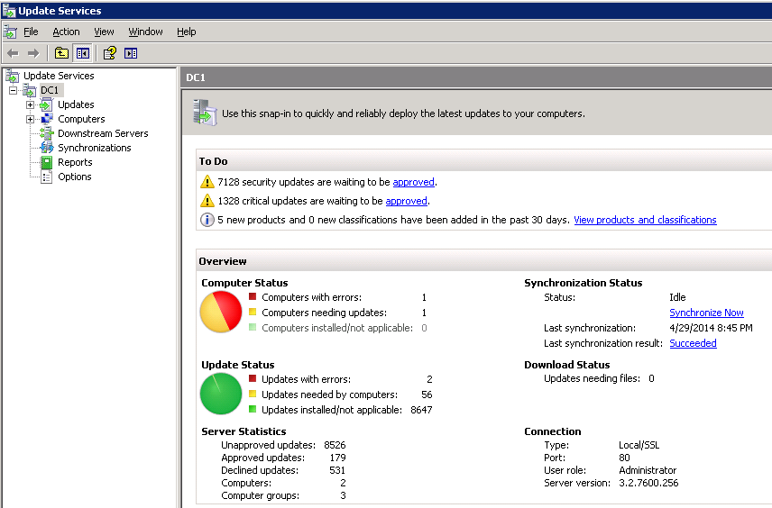
Options to Explore WSUS
WSUS Administrator Console
Manage WSUS updates, clients, etc…
It’s a GUI!
Zero Automation
Limited Reporting

Slide 6
Options to Explore WSUS (Cont.)
UpdateServices Module
Official Microsoft Module
Limited to 12 cmdlets at this time
Better automation and reporting
Available in Windows 8 and Windows Server 2012 only

Slide 7
Options to Explore WSUS (Cont.)
WSUS API (.Net classes) – I’m covering this
Great flexibility to explore WSUS
Reporting on everything
Automation of practically everything WSUS
Requires more knowledge of working with the API

Slide 8
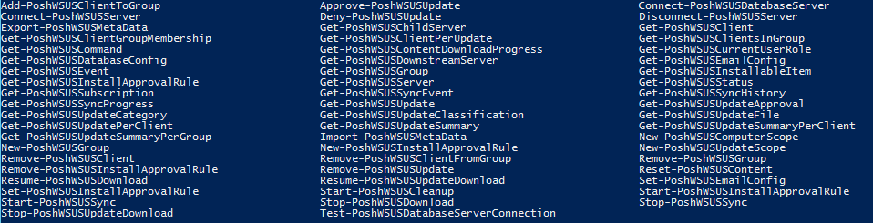
Options to Explore WSUS (Cont.)
PoshWSUS Module
3rd party module
76 Functions
Manage most of WSUS to include configuration of server
Automation and Reporting
Less complex to use vs. API

Slide 9
Topics Covered
Creating an Initial Connection and Viewing Methods
WSUS Configuration, Events and Database access
Working with Clients and Target Groups
Searching and Approving/Declining Updates
Configuring Automatic Approvals
WSUS Reporting

Slide 10
Demo – Getting started
Loading the assembly
Make initial WSUS Connection
View available methods
LOTS OF THEM!!!!!

Slide 11
Demo – WSUS Configuration and Events
View WSUS Configuration
View WSUS Events
WSUS Synchronization history
SUSDB Database Exploration
SUSDB Maintenance

Slide 12
Demo – Clients/Groups
Querying Clients
Adding/removing clients from groups
Removing Clients from WSUS
Creating/removing WSUS Target Groups

Slide 13
Demo - Updates
Locating Updates
Finding update files associated with updates
Approving updates
Declining updates

Slide 14
Demo – Automatic Approvals
Query automatic approvals
Create/remove automatic approvals
Running an automatic approval rule

Slide 15
Demo – Reporting
List failed update installations
Computers requiring reboot
Current WSUS update summary
Auditing approvals
HTML Report

Slide 16
PoshWSUS
https://poshwsus.codeplex.com
PowerShell Module to manage WSUS
Not to be confused with UpdateServices module by Microsoft
Try it out and let me know what you think!

Slide 17
PowerShell and WSUS Articles
Hey, Scripting Guy!
http://tinyurl.com/HsgWSUS
PowerShell Magazine
http://tinyurl.com/PoshMagWSUS
My Blog
http://tinyurl.com/LearnPowerShellWSUS

Slide 18




Thanks!
http://learn-powershell.net
http://twitter.com/proxb
http://gplus.to/boeprox
boeprox@gmail.com
Projects:
PoshWSUS – https://poshwsus.codeplex.com
PoshPAIG – https://poshpaig.codeplex.com
PoshEventUI – https://posheventui.codeplex.com
PoshChat – https://poshchat.codeplex.com

